Slide 1


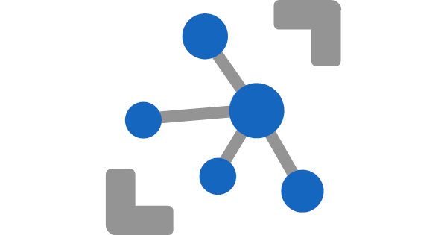


IoT Solution/Smart Start using - Azure IoTHub, - Azure Stream Analytics - and Azure SQL
Meinrad Weiss
SR Cloud Solution Architect
28.07.2022

Slide 2
Agenda
History, Goal and Solution Overview
Deploy Solution
Internals
Auto Signal Registration
Handle Duplicate Values
Storage Details
Poor man’s digital twin
Restrict Data Access
Efficient Queries/Power BI
Monitor activity/reset the database
Database Tiers

Slide 3
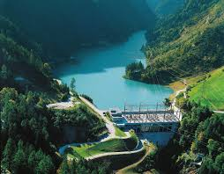




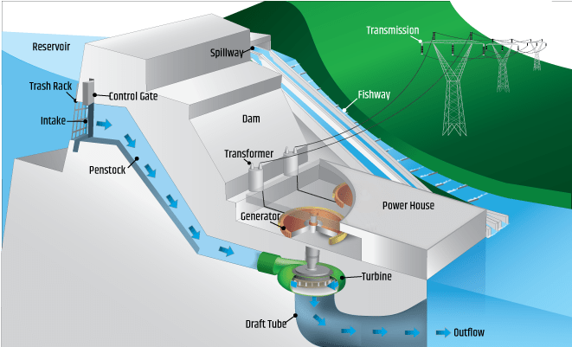


Source of the Architecture (Axpo Hydro)
IoT Edge
IoT Hub
Stream Analytics
Azure SQL Database
Web
Application
Azure
Machine
Learning
/Azure Functions
Third
Party

Slide 4
Main goals/requirements and features
Optimal ingest and query performance
Minimal impact if database grows
Use PaaS services and functionality
Auto registration of new Devices/Signals
Avoid duplicate delivery of events
(Keep them for quality control)
Deal with mal formed events
(Keep them for quality control)
Show data only allowed rows, company internal but also for third party users
IoT Hub
Stream Analytics
Azure SQL Database
Keep history of all security relevant meta data changes
Replace signal name with internal SignalId
(Tuned for efficiency)
Reference
Data

Slide 5

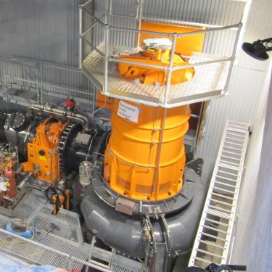

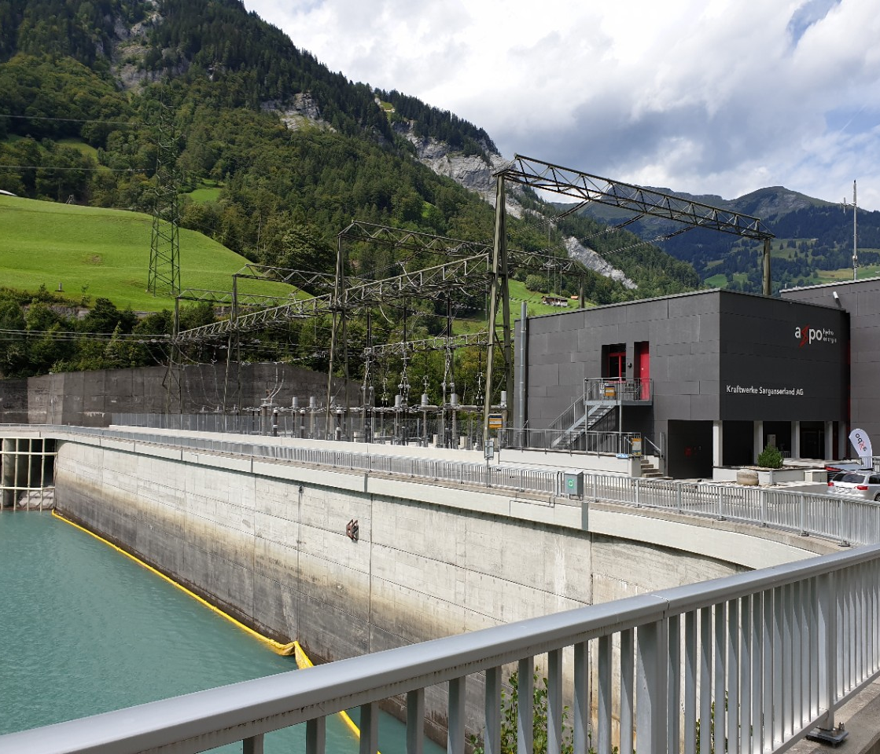

Facts & Figures
6 Power Plants
10 Locations
~ 70’000 Measurement Points
~ 40’000’000 Events per Day

Slide 6
Facts & Figures
6 Power Plants
10 Locations
~ 70’000 Measurement Points
~ 40’000’000 Events per Day

Slide 7
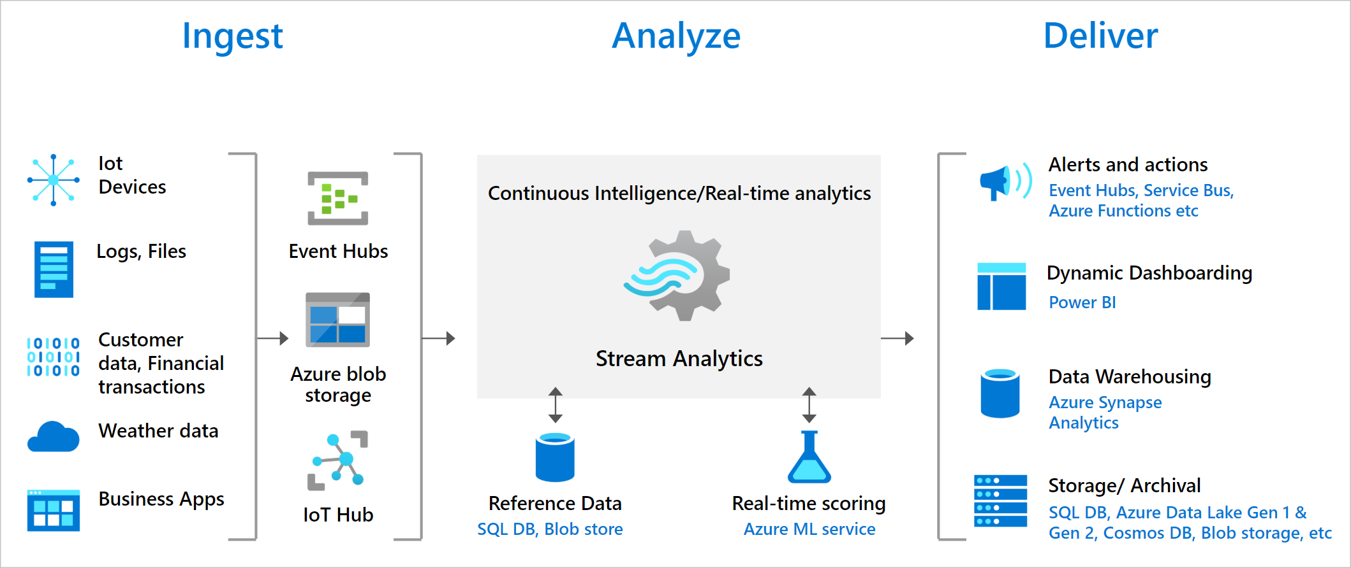
Azure Stream Analytics
Azure Stream Analytics is a real-time analytics and complex event-processing engine that is designed to analyze and process high volumes of fast streaming data from multiple sources simultaneously. Azure Stream Analytics | Microsoft Azure

Slide 8
Data ingest and presentation
Avoid duplicate delivery of events
(Keep them for quality control)
Deal with mal formed events
(Keep them for quality control)
Show data only allowed rows, company internal but also for third party users
IoT Hub
Stream Analytics
Azure SQL Database
Keep history of all security relevant meta data changes
Replace signal name with internal SignalId
(Tuned for efficiency)
Reference
Data

Slide 9
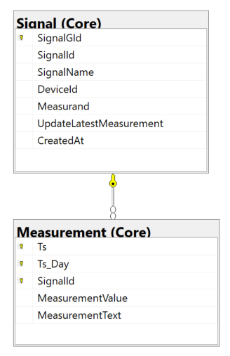
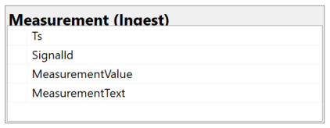
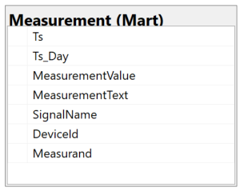
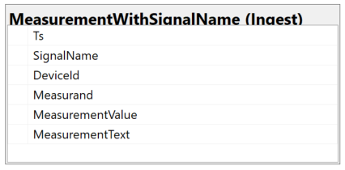
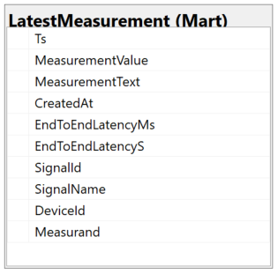
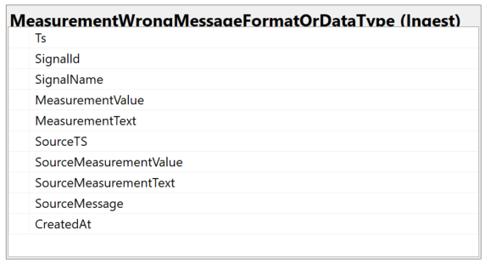
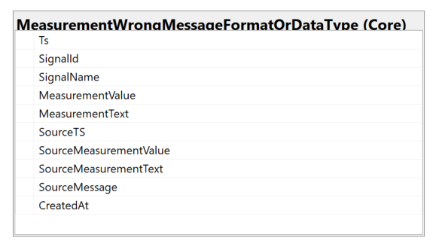
Main Azure SQL Database Structures
Ingest
Core
Mart
Stream Analytics

Slide 10
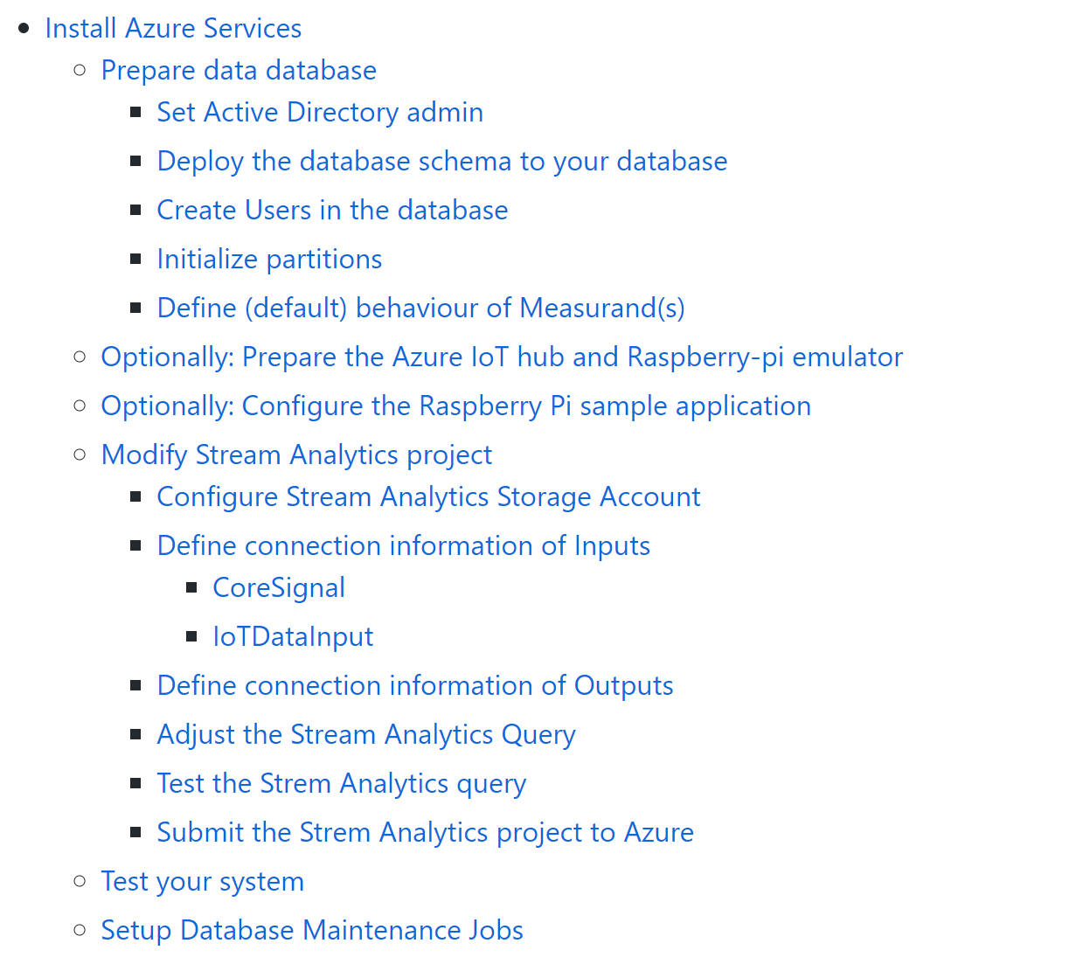

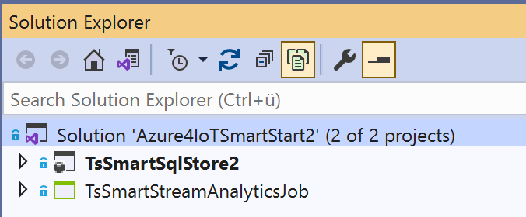
Deployment
https://github.com/meinradweiss/Azure4IoTSmartStart2Public

Slide 11
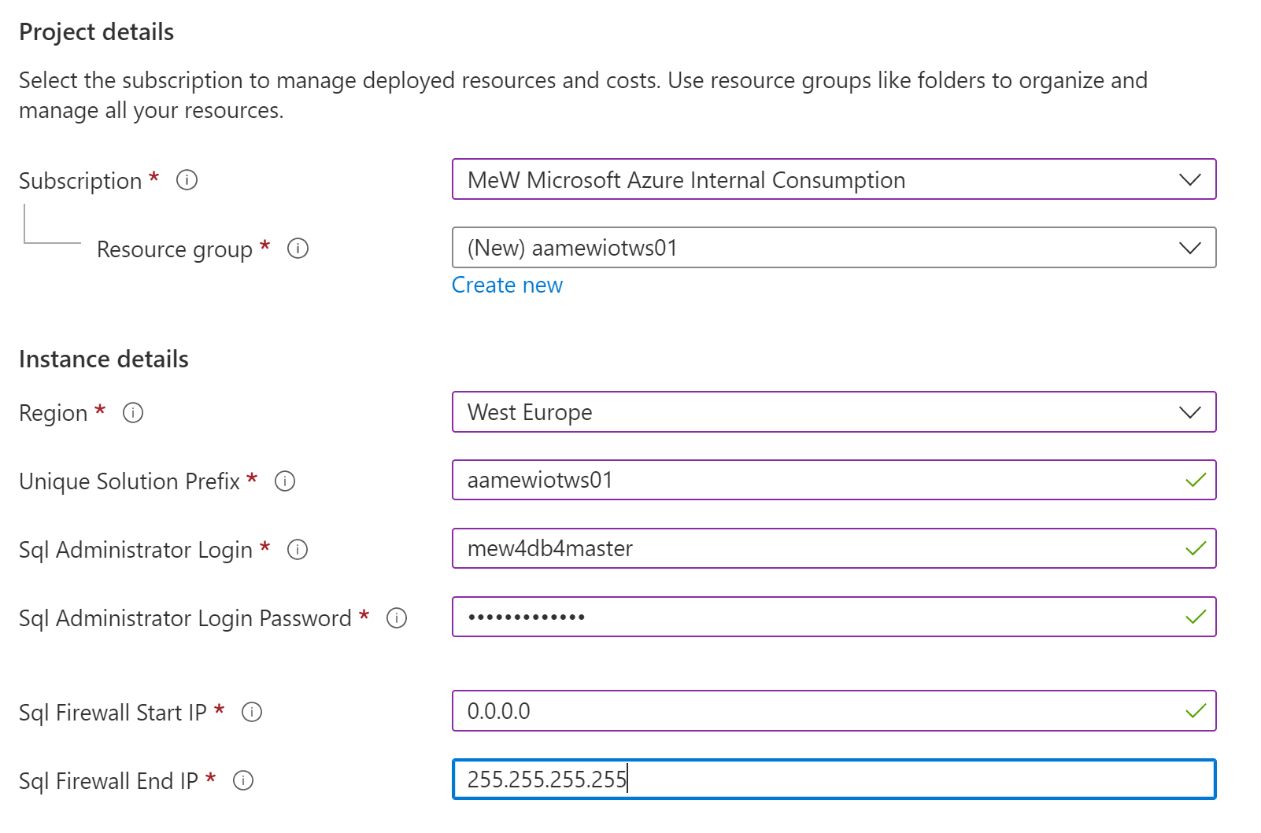
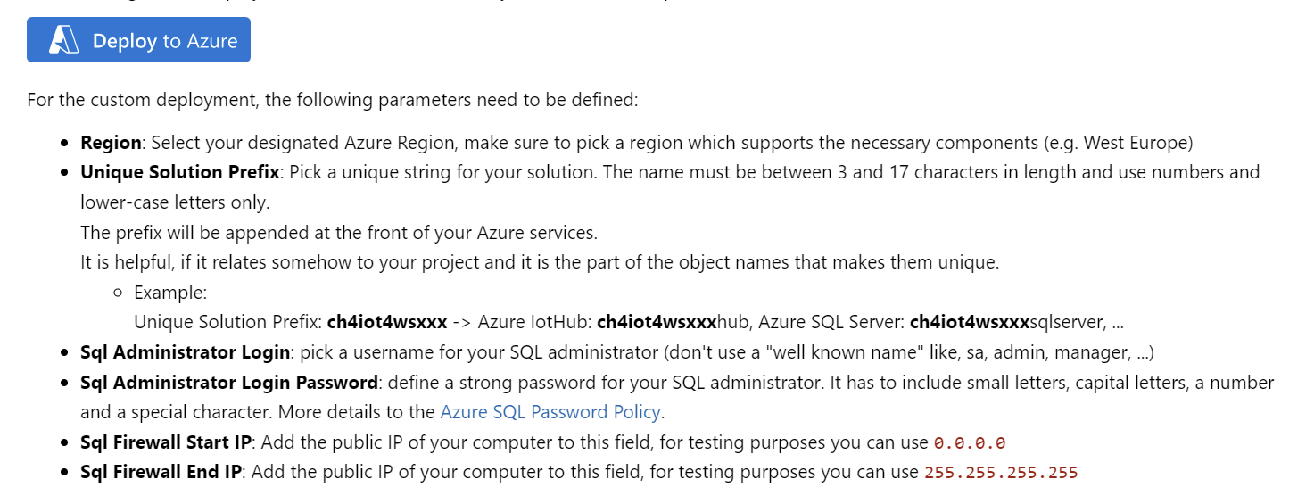
Deploy Azure Services
Notes:
az group deployment create --name <ExampleDeployment> --resource-group <YourResourceGroup> --template-file azuredeployBasic.json

Slide 12
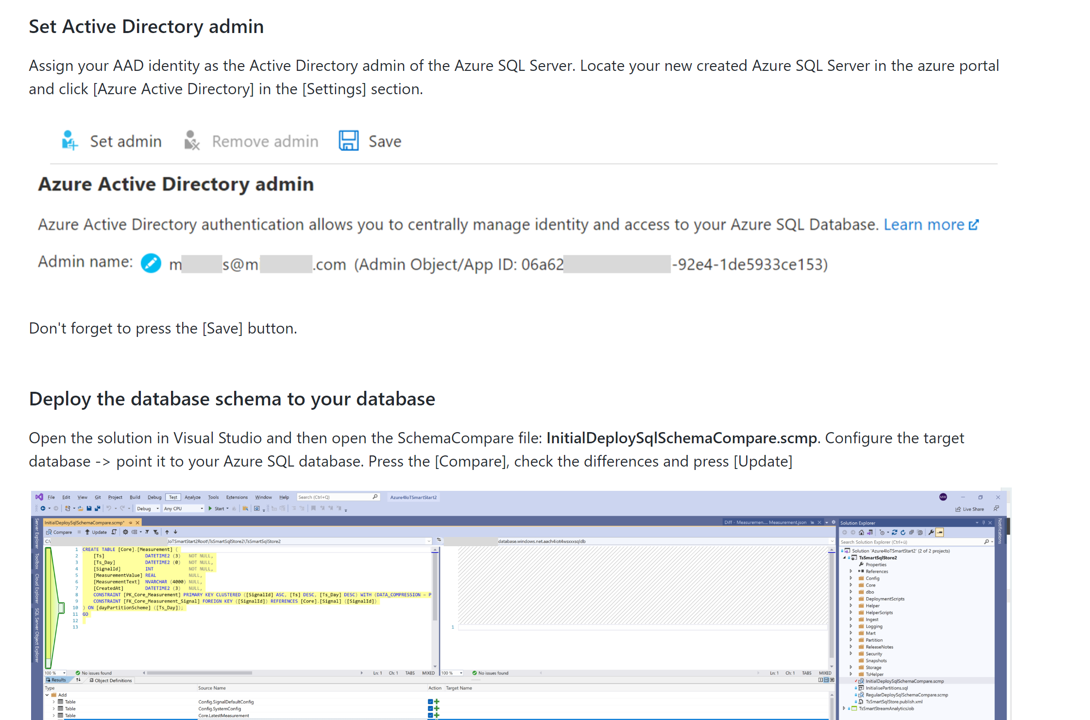
Deploy SQL Database Schema
1

Slide 13
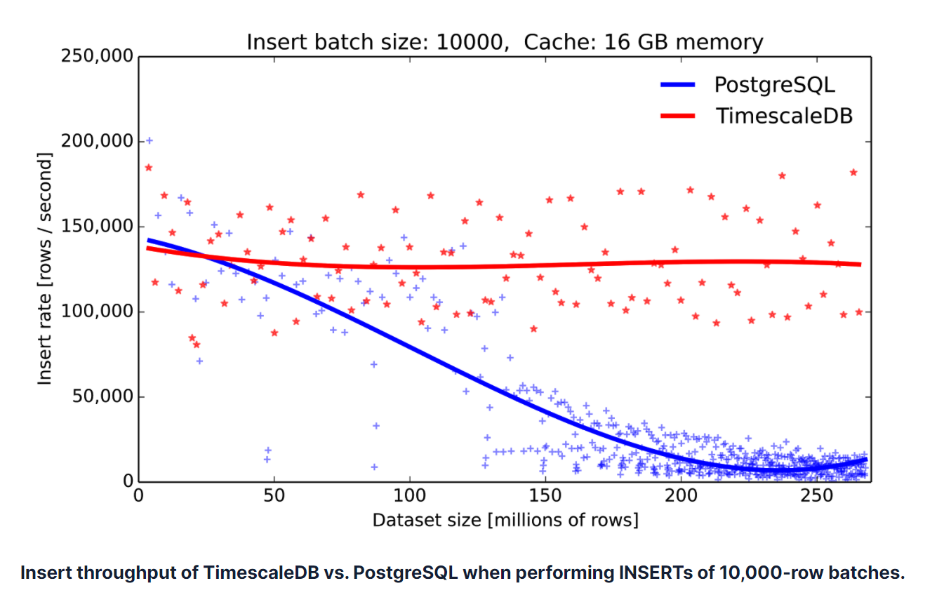


Adjust DB to your project
Source:
Time-series data: Why to use a relational database instead of NoSQL (timescale.com)
1
Goal
Partitions are key to keep performance at an optimal level, even if database is growing
One of the key features of TimescaleDB
Partition borders must cover the time range of the IoT data stored in the database
To maintain the partition border in the future a daily job must be setup (e.g., Data Factory, Synapse Pipelines, Logic App, Data Job, Airflow, Elastic DB Jobs (preview) …)
DECLARE @startDate date
DECLARE @dayAheadNumber int
SET @startDate = GETDATE() -- If we get data starting "today"
SET @dayAheadNumber = 35 -- Default
EXECUTE [Partition].[MaintainPartitionBorders] @startDate, @dayAheadNumber
Schedule once a day
EXECUTE [Partition].[MaintainPartitionBorders]

Slide 14
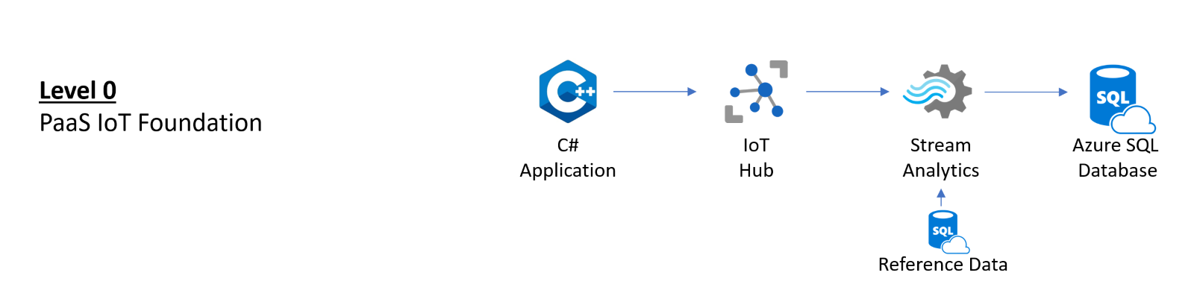
Adjust DB to your project - 2
x
1
x
Add “Stream Analytics” users to the database
Using a ‘managed identity’
Using SQL Server Logins
x
-- In your IoT database
CREATE USER [<ASA_JOB_NAME>] FROM EXTERNAL PROVIDER;
GRANT SELECT, INSERT ON SCHEMA::INGEST TO [<ASA_JOB_NAME>];
GRANT SELECT ON OBJECT::[Core].[Signal] TO [<ASA_JOB_NAME>];
-- In your IoT database
CREATE USER [ASA_MetaDataReader] WITH PASSWORD = '<your strong password 8fdKJl3$nlNv3049jsKK>';
CREATE USER [ASA_TelemetryWriter] WITH PASSWORD = '<your strong password2 9fdKJ85$nlNv3049jsKK#';
GRANT SELECT ON OBJECT::[Core].[Signal] TO [ASA_MetaDataReader]; GRANT SELECT, INSERT ON SCHEMA::INGEST TO [ASA_TelemetryWriter];

Slide 15
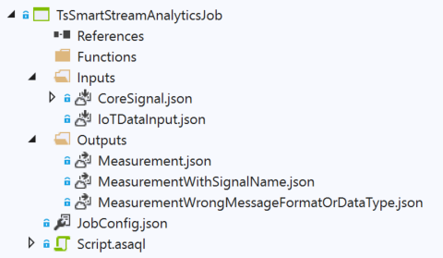
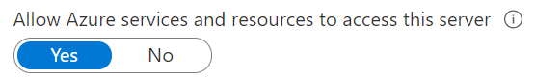
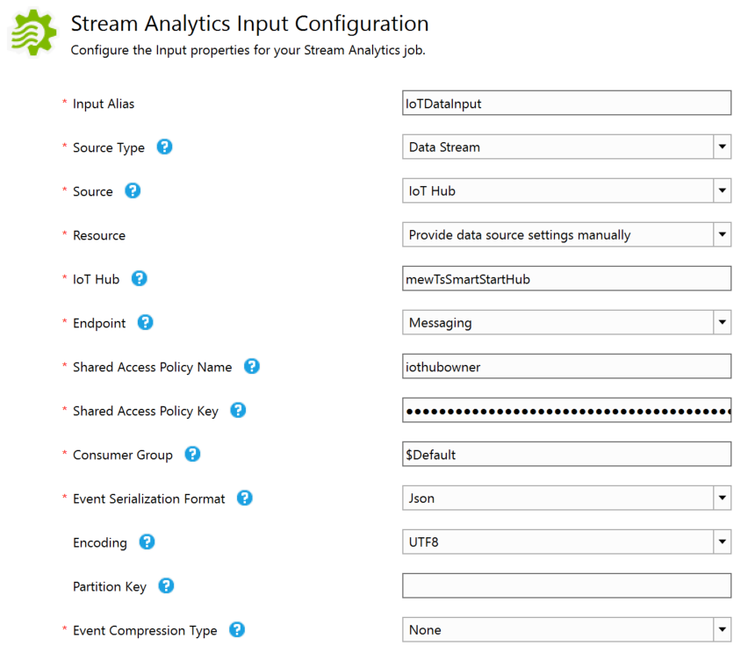
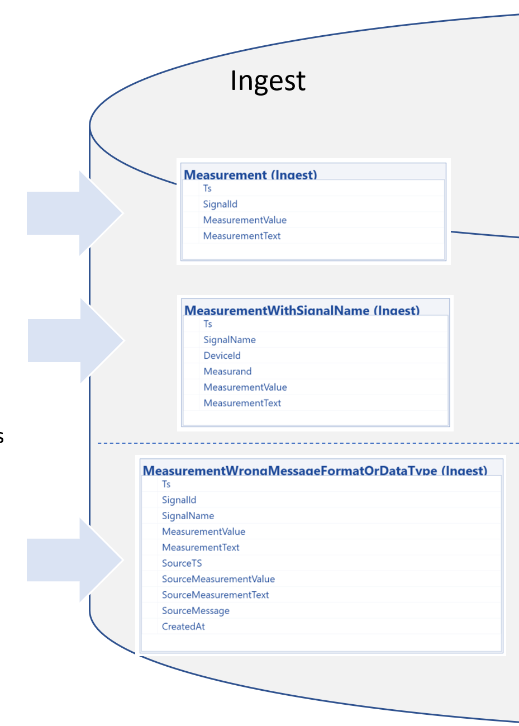
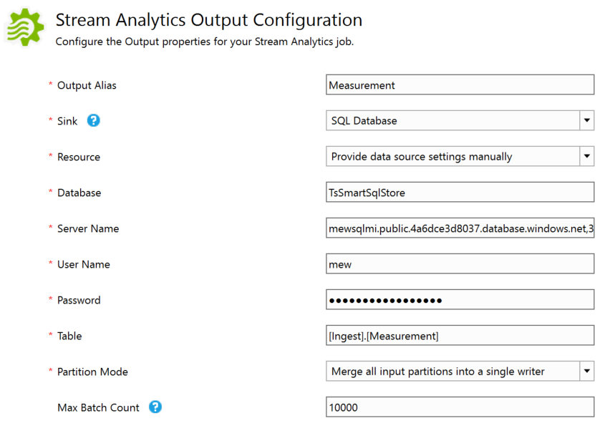
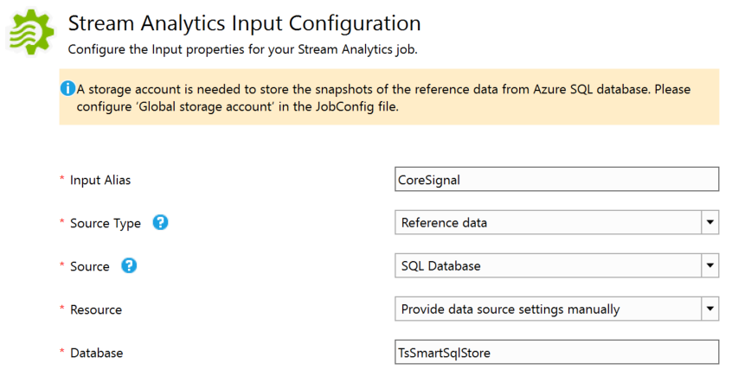
Define and Deploy Stream Analytics Job
Grant access to Azure Services
SELECT [SignalId], [SignalName]
FROM [Core].[Signal]

Slide 16
Define and Deploy Stream Analytics Job - 2
WITH IoTDataInputWithSignalName AS (SELECT
TRY_CAST(EventTimestamp AS DATETIME) AS [Ts]
,IoTHub.ConnectionDeviceId AS [DeviceId]
,SignalLabel AS [Measurand]
,CONCAT(IoTHub.ConnectionDeviceId, '_', SignalLabel) AS [SignalName]
,TRY_CAST([Value] AS FLOAT) AS [MeasurementValue]
,CASE WHEN TRY_CAST([MeasurementValue] AS FLOAT) IS NULL
THEN [MeasurementValue]
ELSE NULL
END AS [MeasurementText]
,EventTimestamp AS [SourceTS]
,[Value] AS [SourceMeasurementValue]
,[Text] AS [SourceMeasurementText]
,[IoTDataInput] AS [SourceMessage]
FROM [IoTDataInput])
,IoTDataInputWithSignalId AS (SELECT [IoTInput].[Ts]
,[IoTInput].[DeviceId]
,[IoTInput].[Measurand]
,[CoreSignal].[SignalId]
,[IoTInput].[SignalName]
,[IoTInput].[MeasurementValue]
,[IoTInput].[MeasurementText]
,[IoTInput].[SourceTS]
,[IoTInput].[SourceMeasurementValue]
,[IoTInput].[SourceMeasurementText]
,[IoTInput].[SourceMessage]
FROM [IoTDataInputWithSignalName] AS [IoTInput]
LEFT OUTER JOIN [CoreSignal]
ON [IoTInput].[SignalName] = [CoreSignal].[SignalName] )
Message from IoT Hub
{
"EventTimestamp": "2021-12-08T14:01:14.5094082Z",
"SignalLabel": "Temperature",
"Value": "12.34",
"Text": "",
"EventProcessedUtcTime": "2021-12-08T14:01:14.5771421Z",
"PartitionId": 1,
"EventEnqueuedUtcTime": "2021-12-08T14:01:15.0040000Z",
"IoTHub": {
"MessageId": null,
"CorrelationId": null,
"ConnectionDeviceId": "mewTsSmartStartHubDevice001",
"ConnectionDeviceGenerationId": "637740536776612383",
"EnqueuedTime": "2021-12-08T14:01:15.0050000Z"
}
}
Device Message
{
"EventTimestamp": "2021-12-08T13:45:37.5349406Z",
"SignalLabel": "Humidity",
"Value": "67.26993883367159",
"Text": ""
}
Code depends on incoming message structure
“Generic” Code, try to resolve SignalName and provide SignalId

Slide 17
Define and Deploy Stream Analytics Job - 3
3
[MeasurementWrongMessageFormatOrDataType]
SELECT [Ts]
,[SignalId]
,[SignalName]
,[MeasurementValue]
,[MeasurementText]
,[SourceTS]
,[SourceMeasurementValue]
,[SourceMeasurementText]
,[SourceMessage]
INTO [MeasurementWrongMessageFormatOrDataType]
FROM [IoTDataInputWithSignalId]
WHERE [Ts] IS NULL
OR [SignalName] IS NULL
OR (([MeasurementValue] IS NULL)
AND ([MeasurementText] IS NULL)
)
“Generic Code”:
No timestamp or no SignalName or no “Payload”

Slide 18
Define and Deploy Stream Analytics Job - 4
3
[MeasurementWithSignalName]
SELECT [Ts]
,[SignalName]
,[DeviceId]
,[Measurand]
,[MeasurementValue]
,[MeasurementText]
INTO [MeasurementWithSignalName]
FROM [IoTDataInputWithSignalId]
WHERE [Ts] IS NOT NULL
AND ([MeasurementValue] IS NOT NULL
OR [MeasurementText] IS NOT NULL
)
AND [SignalName] IS NOT NULL
AND [SignalId] IS NULL
“Generic Code”:
Timestamp, SignalName and “Payload” is available, but no SignalId

Slide 19
Define and Deploy Stream Analytics Job - 5
3
[Measurement]
SELECT [IoTInput].[Ts]
,[CoreSignal].[SignalId] ,[IoTInput].[MeasurementValue]
,[IoTInput].[MeasurementText]
INTO [Measurement]
FROM [IoTDataInputWithSignalName] AS [IoTInput]
INNER JOIN [CoreSignal]
ON [IoTInput].[SignalName] = [CoreSignal].[SignalName]
WHERE [IoTInput].[Ts] IS NOT NULL
AND ([IoTInput].[MeasurementValue] IS NOT NULL
OR [IoTInput].[MeasurementText] IS NOT NULL )
“Generic Code”:
Timestamp, SignalId and “Payload” is available

Slide 20
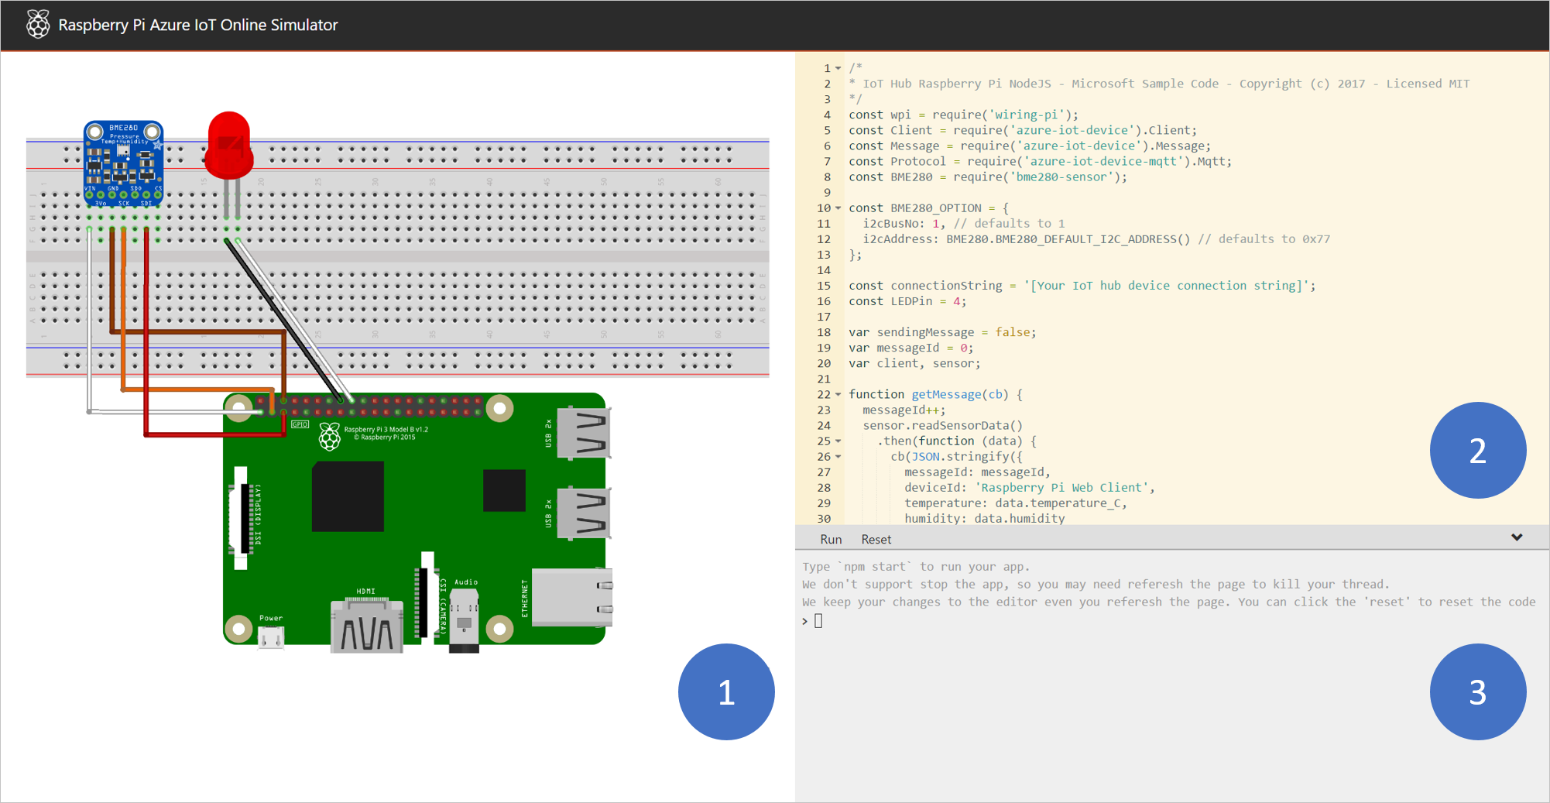
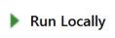
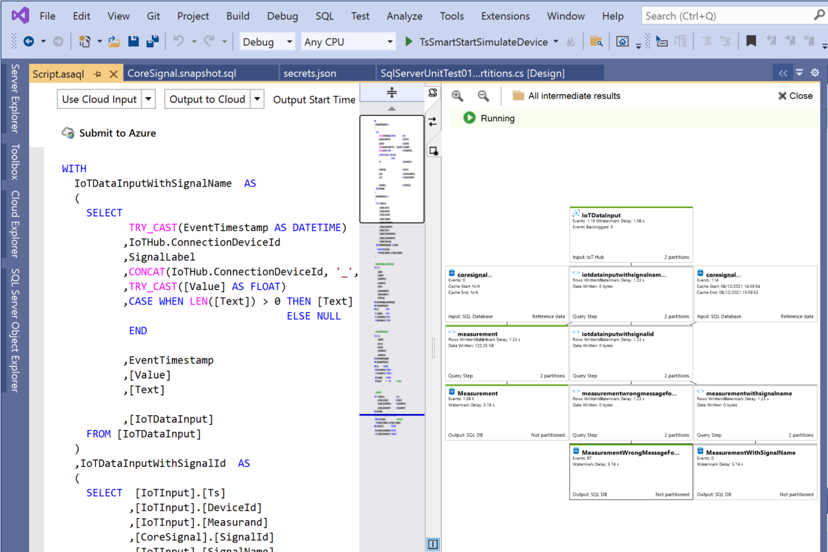
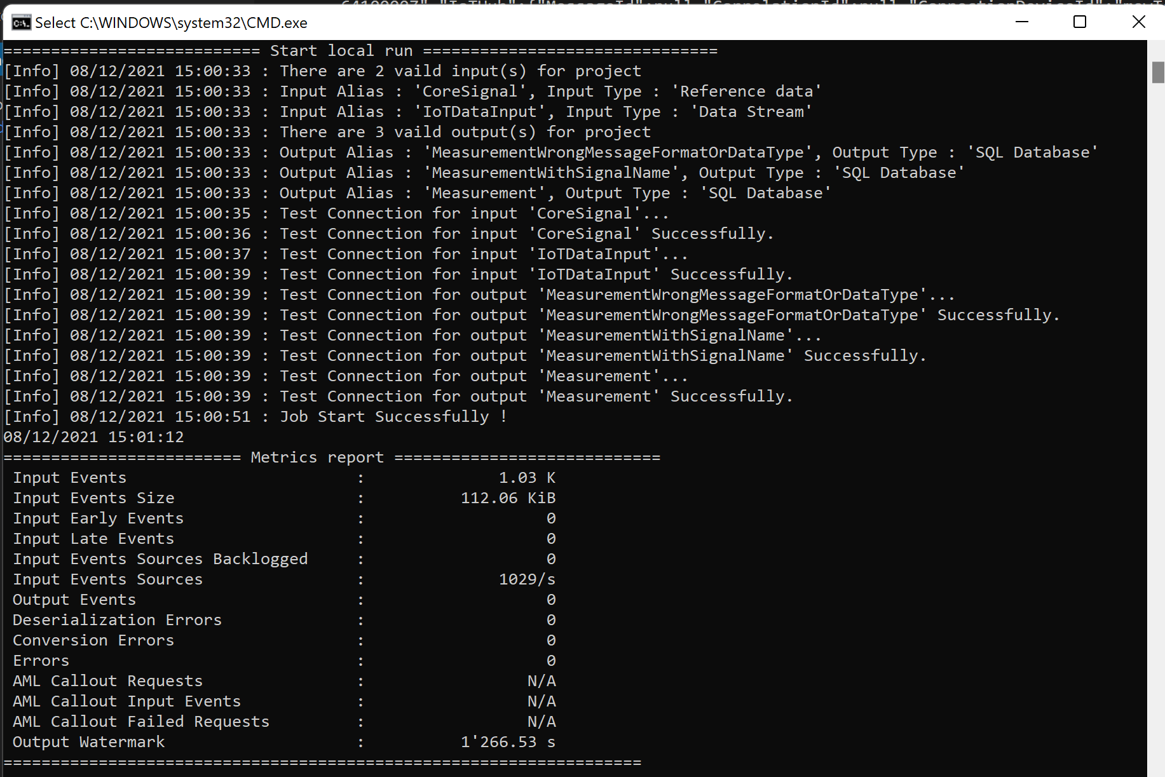
Test Setup in Visual Studio
Raspberry Pi web simulator
Configure simulator
Start it
TsSmartStreamAnalyticsJob
Define Use Cloud Input/Use Cloud Output and Click

Slide 21
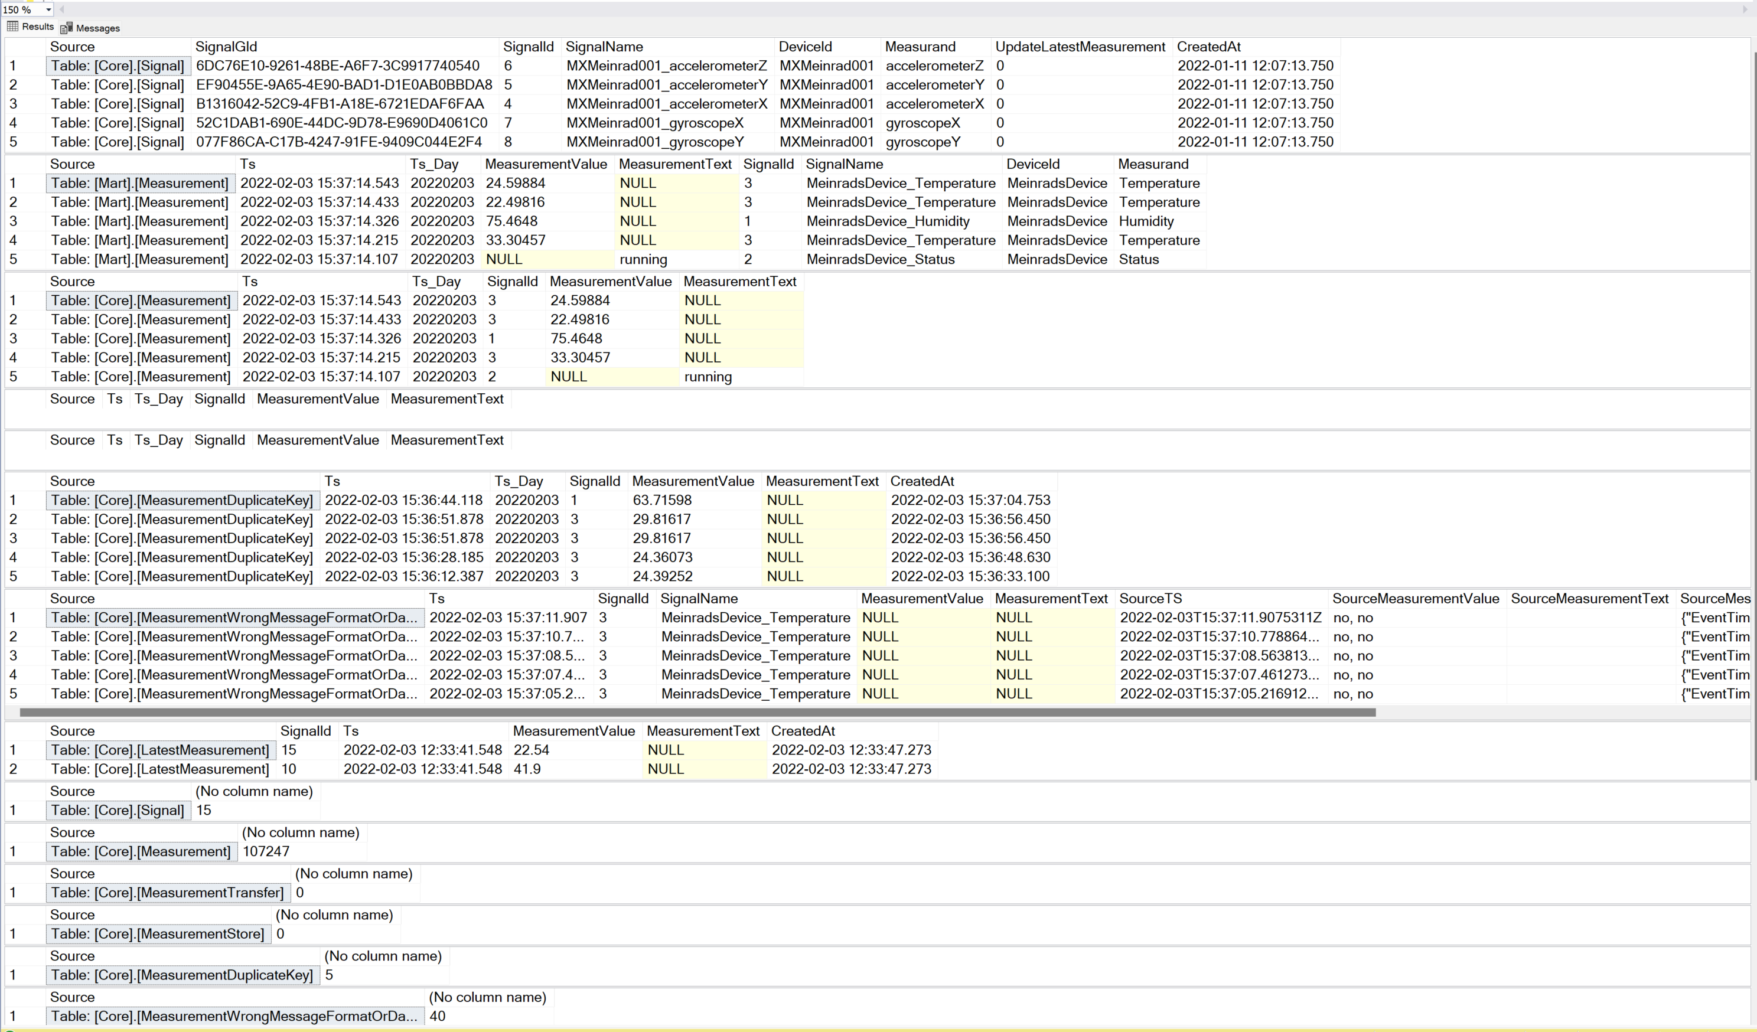
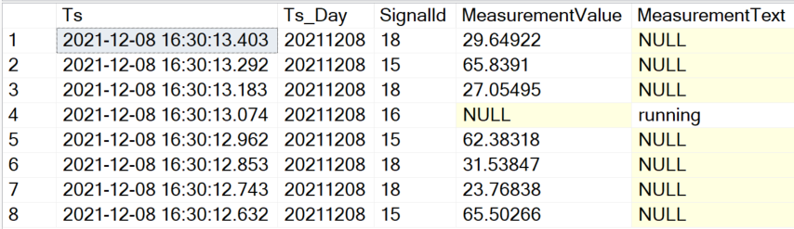
Check Data in Database
SELECT *
FROM [Core].[Signal]
SELECT top 8 *
FROM [Core].[Measurement]
ORDER BY [Ts] DESC
SELECT top 6 *
FROM [Core].[MeasurementWrongMessageFormatOrDataType]
ORDER BY [Ts] DESC
Stored Procedure:[Core].[GetOverviewOfDataInDatabase]

Slide 22
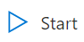
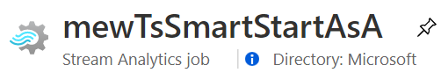
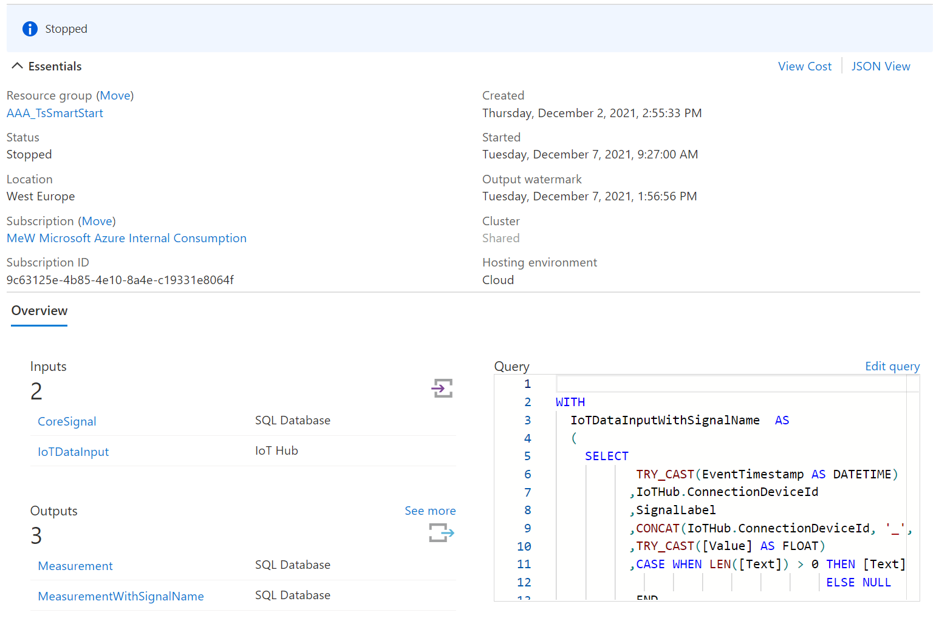
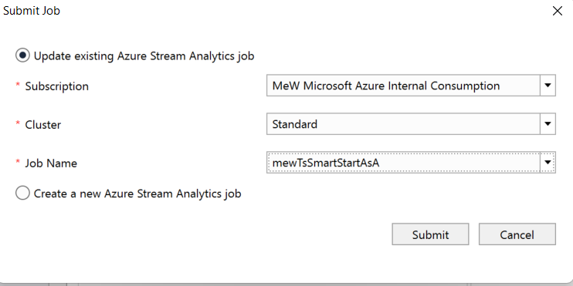
Deploy Stream Analytics Job
3
TsSmartStreamAnalyticsJob
Click

Slide 23
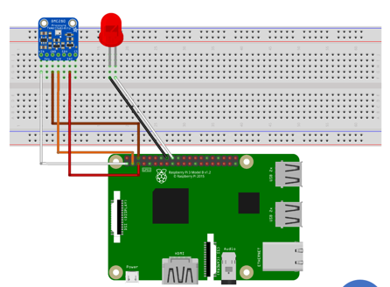
Ready to run
Ingest
Core
Mart
Stream Analytics

Slide 24
Agenda
Goal and Solution Overview
Deploy Solution
Internals
Auto Signal Registration
Handle Duplicate Values
Storage Details
Poor man’s digital twin
Restrict Data Access
Efficient Queries/Power BI
Monitor activity/reset the database
Database Tiers

Slide 25
More Details
Avoid duplicate delivery of events
(Keep them for quality control)
Deal with mal formed events
(Keep them for quality control)
Show data only allowed rows, company internal but also for third party users
IoT Hub
Stream Analytics
Azure SQL Database
Keep history of all security relevant meta data changes
Replace signal name with internal SignalId
Reference
Data

Slide 26
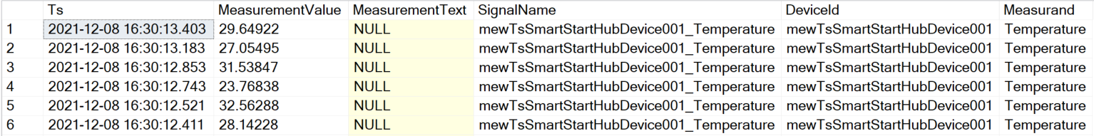
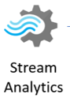
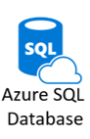

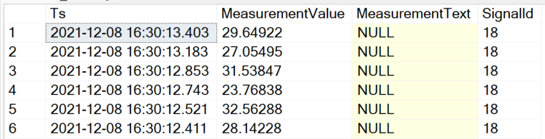
Signal Registration Process
[Ingest].[MeasurementWithSignalName]
{
"EventTimestamp": "2021-12-08T14:01:14.5094082Z",
"SignalLabel": "Temperature",
"Value": "12.34",
"Text": "",
"EventProcessedUtcTime": "2021-12-08T14:01:14.5771421Z",
"PartitionId": 1,
"EventEnqueuedUtcTime": "2021-12-08T14:01:15.0040000Z",
"IoTHub": {
"MessageId": null,
"CorrelationId": null,
"ConnectionDeviceId": "mewTsSmartStartHubDevice001",
"ConnectionDeviceGenerationId": "637740536776612383",
"EnqueuedTime": "2021-12-08T14:01:15.0050000Z"
}
}
[Ingest].[Measurement]

Slide 27
Main Azure SQL Database Structures
Instead of INSERT Trigger
Ingest
Core
Mart
Stream Analytics
Creates missing signals and stores them in [Core].[Signal]
Resolves [SignalId] and routes the event to [Ingest].[Measurement]

Slide 28
Auto Signal Registration
CREATE TRIGGER [Ingest].[IngestMeasurementWithSignalNameInsteadOfInsertTrigger]
ON [Ingest].[MeasurementWithSignalName]
INSTEAD OF INSERT
AS
SET NOCOUNT ON;
-- Insert missing signal name into Signal table
INSERT INTO [Core].[Signal]
([SignalName]
,[DeviceId]
,[Measurand])
SELECT DISTINCT [SignalName], [DeviceId], [Measurand]
FROM INSERTED
WHERE NOT EXISTS (SELECT 'X' FROM [Core].[Signal] AS s WHERE s.[SignalName] = INSERTED.[SignalName]);
-- Copy events to regular Measurement ingest facade
INSERT INTO [Ingest].[Measurement]
([Ts]
,[SignalId]
,[MeasurementValue]
,[MeasurementText])
SELECT [Ts]
,[SignalId]
,[MeasurementValue]
,[MeasurementText]
FROM INSERTED AS i
INNER JOIN [Core].[Signal] AS s
ON i.[SignalName] = s.[SignalName];
GO

Slide 29
Handle Duplicate Values
Event Delivery Guarantees (Azure Stream Analytics)
Exactly-once processing
Azure Stream Analytics guarantees exactly once processing.
Exactly-once delivery
Azure Stream Analytics guarantes at-least-once delivery to output sinks, which guarantees that all results are outputted, but duplicate results may occur. However exactly-once delivery may be achieved with several outputs such as Cosmos DB or SQL
The Azure instance is upgraded while the job is running
The Stream Analytics job is upgraded or an issue occurs with connectivity or reliability to the job output
The Azure instance running the job has an outage
Stream Analytics job is started with the when last stopped option

Slide 30
Handle Duplicate Values - 2
Cosmos DB
Using Cosmos DB, Azure Stream Analytics guarantees exactly-once delivery. Since Azure Stream Analytics uses upsert, no action is needed by the user. See more information on Azure Stream Analytics output to CosmosDB.
SQL
When using SQL output, users can achieve exactly-once delivery if the following requirements are met:
all output streaming events have a natural key, i.e. are uniquely identifiable either by a field or a combination of fields.
the output SQL table has a unique constraint (or primary key) created using the natural key of the output events.
This is sufficient to avoid duplicates because the SQL output honors any constraints placed on the table by skipping any events that cause a unique constraint violation.
Avoid duplicate delivery of events
(Keep them for quality control)
Just skipping means the fact that duplicates occurred disappears

Slide 31
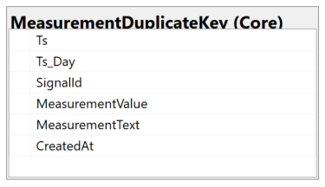
Handle Duplicate Values - 4
Instead of INSERT Trigger
Ingest
Core
Stream Analytics
Detect duplicate events and stores them in exception table [Core].[MeasurementDuplicateKey]
Calculates Partition Key Attribute and stores new events in [Core].[Measurement]

Slide 32
Handle Duplicate Values - 5
CREATE TRIGGER [Ingest].[IngestMeasurementInsteadOfInsertTrigger]
ON [Ingest].[Measurement]
INSTEAD OF INSERT
AS
SET NOCOUNT ON;
-- This is new
-- Store measurements that already exist in the duplicate key table.
INSERT INTO [Core].[MeasurementDuplicateKey]
( [Ts]
,[Ts_Day]
,[SignalId]
,[MeasurementValue]
,[MeasurementText]
,[CreatedAt])
SELECT
i.[Ts]
,CONVERT(INT, CONVERT(VARCHAR, i.[Ts], 112)) as Ts_Day -- Calculate partition Key
,CONVERT(INT, i.[SignalId])
,i.[MeasurementValue]
,i.[MeasurementText]
,GETDATE()
FROM INSERTED as i
INNER JOIN [Core].[AllMeasurement] as m
ON i.[SignalId] = m.[SignalId]
AND i.[Ts] = m.[Ts]
AND m.[Ts_Day] = CONVERT(DATETIME, CONVERT(DATE, i.[Ts]))-- Enable partition elimination
...

Slide 33
Handle Duplicate Values – 5a
2nd part of TRIGGER [Ingest].[IngestMeasurementInsteadOfInsertTrigger]
...
-- Insert duplicate records if the happen in one batch of data
INSERT INTO [Core].[MeasurementDuplicateKey]
( [Ts]
,[Ts_Day]
,[SignalId]
,[MeasurementValue]
,[MeasurementText]
,[CreatedAt])
SELECT [INSERTED].[Ts]
,CONVERT(DATE, [INSERTED].[Ts]) AS [Ts_Day] -- Calculate partition Key
,CONVERT(INT, [INSERTED].[SignalId]) AS [SignalId]
,[MeasurementValue]
,[MeasurementText]
,GETDATE()
FROM [INSERTED]
INNER JOIN (SELECT i.[Ts]
,i.[SignalId]
,COUNT(*) as c
FROM INSERTED as i
GROUP BY i.[Ts]
,i.[SignalId]
HAVING COUNT(*) > 1
) AS DUPLICATE_ROWS
ON [INSERTED].[Ts] = [DUPLICATE_ROWS].[Ts]
AND [INSERTED].[SignalId] = [DUPLICATE_ROWS].[SignalId]

Slide 34
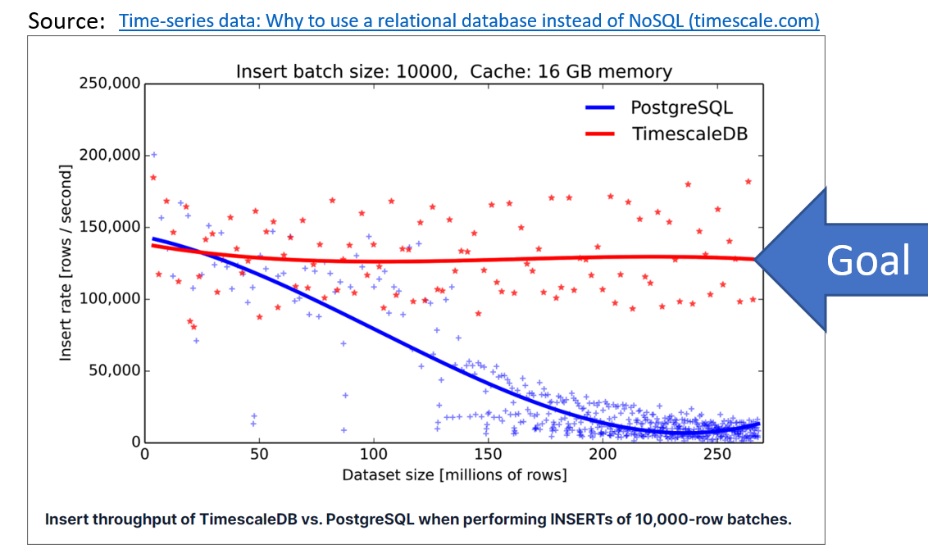
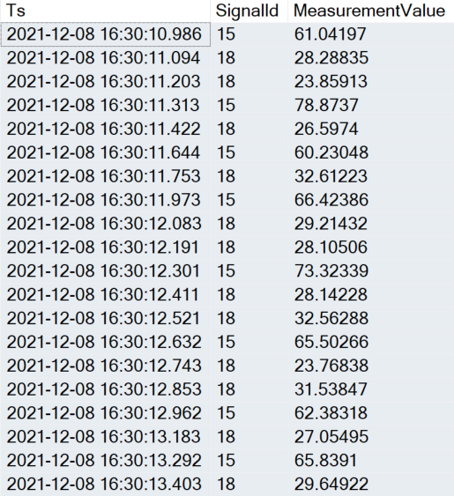
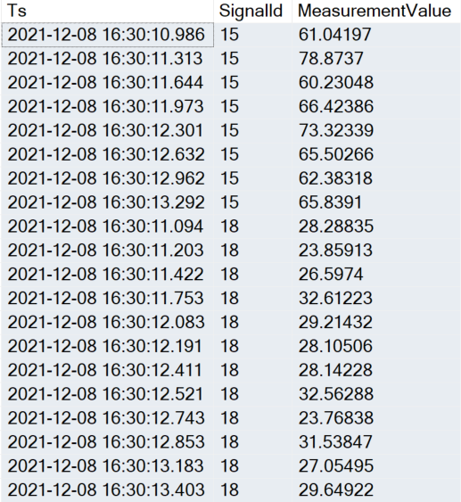
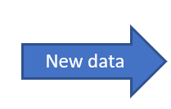
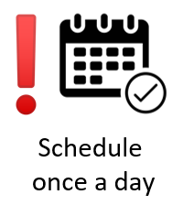
Storage Details – Basic Usage
IoT data arrives in batches
“ordered by” Ts
The typical query for Time Series data is:
select [Ts], [SignalId], [MeasurementValue]
from [Core].[Measurement]
where [SignalId] = 15
AND [Ts] between '2021-12-08 16:30:05' and '2021-12-08 16:30:10.876'
order by SignalId, TS
The index will be extremely fragmented
after a few inserts
ALTER TABLE [Core].[Measurement]
ADD CONSTRAINT [PK_Core_Measurement] PRIMARY KEY CLUSTERED
([SignalId] ASC,
[Ts] DESC,
[Ts_Day] DESC
)
[Core].[Measurement]
[Core].[Measurement]
Today -2
Today -2
Today -1
Today -1
New data
Today
New data
Today
EXEC [Core].[RebuildFragmentedIndexes]
Fragmented
Not fragmented

Slide 35
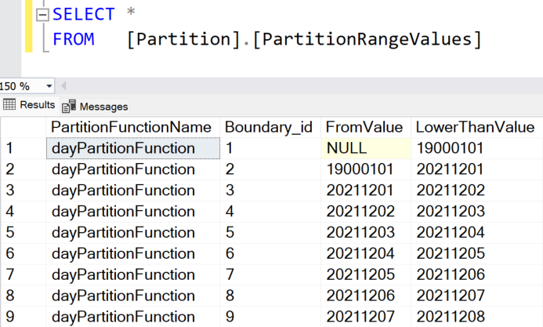
Storage Details – Basic Usage -2
Day Partition Objects
CREATE TABLE [Core].[Measurement] (
[Ts] DATETIME2 (3) NOT NULL,
[Ts_Day] INT NOT NULL,
[SignalId] INT NOT NULL,
[MeasurementValue] REAL NULL,
[MeasurementText] NVARCHAR (2000) NULL,
[MeasurementContext] NVARCHAR (2000) NULL,
[CreatedAt] DATETIME2 (3) NULL,
CONSTRAINT [PK_Core_Measurement] PRIMARY KEY CLUSTERED ([SignalId] ASC, [Ts] DESC, [Ts_Day] DESC) WITH (DATA_COMPRESSION = PAGE) ON [dayPartitionScheme] ([Ts_Day]),
CONSTRAINT [FK_Core_Measurement_Signal] FOREIGN KEY ([SignalId]) REFERENCES [Core].[Signal] ([SignalId])
) ON [dayPartitionScheme] ([Ts_Day]);
CREATE PARTITION SCHEME [dayPartitionScheme] AS PARTITION [dayPartitionFunction]
TO ([PRIMARY], [PRIMARY]);
Partition 1: > 19000101
Partition 2: >= 19000101
19000101
EXECUTE [Partition].[MaintainPartitionBorders]
CREATE PARTITION FUNCTION [dayPartitionFunction](INT)
AS RANGE RIGHT FOR VALUES (19000101);
Creates new partitions for the upcoming days (~ + 40 days in future)

Slide 36
Storage Details – Advanced Usage
For large data history, day partitioning leads to too many partitions
There is a mixed model with day and month partitions
[Core].[OptimiseDataStorage]
Table: [Core].[MeasurementStore]
(Month partition)
View:
[Core].[AllMeasurement]
Table:
[Core].[Measurement]
(Day partition)
A 45.0
B 12.1
C 77.4
A 47.0
B 22.1
C 55.1
A 45.5
B 15.5
D 11.4
A 55.1
B 22.1
C 78.5
A 45.4
B 42.1
D 15.4
A 45.1
B 12.5
C 77.8
A 35.0
B 15.1
C 75.5
A 45.3
B 18.9
C 67.4
20210128
20210129
20210130
20210131
20210202
20210203
20210204
…
20210201
20210301

Slide 37
Storage Details – Advanced Usage
For large data history, day partitioning leads to too many partitions
There is a mixed model with day and month partitions
[Core].[OptimiseDataStorage]
A 45.0
B 12.1
C 77.4
A 47.0
B 22.1
C 55.1
A 45.5
B 15.5
D 11.4
A 45.4
B 42.1
D 15.4
Table: [Core].[MeasurementStore]
(Month partition)
A 55.1
B 22.1
C 78.5
Table: [Core].[MeasurementTransfer]
(Month partition)
[Core].[OptimiseDataStorage]
View:
[Core].[AllMeasurement]
Step 1: Partition Switch
Table:
[Core].[Measurement]
(Day partition)
A 45.1
B 12.5
C 77.8
A 35.0
B 15.1
C 75.5
A 45.3
B 18.9
C 67.4
20210128
20210129
20210130
20210131
20210202
20210203
20210204
…
20210201
20210301

Slide 38
Storage Details – Advanced Usage
For large data history, day partitioning leads to too many partitions
There is a mixed model with day and month partitions
[Core].[OptimiseDataStorage]
A 45.0
B 12.1
C 77.4
A 47.0
B 22.1
C 55.1
A 45.5
B 15.5
D 11.4
A 45.4
B 42.1
D 15.4
Table: [Core].[MeasurementStore]
(Month partition)
A 55.1
B 22.1
C 78.5
Table: [Core].[MeasurementTransfer]
(Month partition)
A 45.1
B 12.5
C 77.8
[Core].[OptimiseDataStorage]
View:
[Core].[AllMeasurement]
Step 1: Partition Switch
Table:
[Core].[Measurement]
(Day partition)
C 69.0
A 29.0
A 35.0
B 15.1
C 75.5
A 45.3
B 18.9
C 67.4
20210128
20210129
20210130
20210131
20210202
20210203
20210204
…
20210201
20210301

Slide 39
Storage Details – Advanced Usage
For large data history, day partitioning leads to too many partitions
There is a mixed model with day and month partitions
[Core].[OptimiseDataStorage]
A 45.0
B 12.1
C 77.4
A 47.0
B 22.1
C 55.1
A 45.5
B 15.5
D 11.4
A 45.4
B 42.1
D 15.4
Table: [Core].[MeasurementStore]
(Month partition)
A 55.1
B 22.1
C 78.5
Step 2: Copy rows
Table: [Core].[MeasurementTransfer]
(Month partition)
A 45.1
B 12.5
C 77.8
[Core].[OptimiseDataStorage]
View:
[Core].[AllMeasurement]
Step 1: Partition Switch
Table:
[Core].[Measurement]
(Day partition)
C 69.0
A 29.0
A 35.0
B 15.1
C 75.5
A 45.3
B 18.9
C 67.4
20210128
20210129
20210130
20210131
20210202
20210203
20210204
…
20210201
20210301
EXEC [Core].[CopyMeasurementFromTs_DayToTs_Day] @FromTs_Day = 20211211, @MoveDaysBack = 14, @OffsetMillisecond = 1
Helpful SP to generate test data
Notes:
EXEC [Core].[OptimiseDataStorage]
EXEC [Core].[CopyMeasurementFromTs_DayToTs_Day] @FromTs_Day = 20211211, @MoveDaysBack = 14, @OffsetMillisecond = 1

Slide 40
Storage Details – Advanced Usage -2
CREATE TABLE [Core].[MeasurementStore] (
[Ts] DATETIME2 (3) NOT NULL,
[Ts_Day] INT NOT NULL,
[SignalId] INT NOT NULL,
[MeasurementValue] REAL NULL,
[MeasurementText] NVARCHAR (2000) NULL,
[MeasurementContext] NVARCHAR (2000) NULL,
[CreatedAt] DATETIME2 (3) NULL
) ON [monthPartitionScheme] ([Ts_Day]);
CREATE NONCLUSTERED INDEX [NCIX_CoreMeasurementStoreTsTs_DaySignalId]
ON [Core].[MeasurementStore]([Ts] ASC, [Ts_Day] ASC, [SignalId] ASC) WITH (DATA_COMPRESSION = PAGE)
ON [monthPartitionScheme] ([Ts_Day]);
CREATE CLUSTERED COLUMNSTORE INDEX [CCI_Core_MeasurementStore]
ON [Core].[MeasurementStore]
ON [monthPartitionScheme] ([Ts_Day]);
Notes:
Check if attribute order in non clustered index makes sense

Slide 41
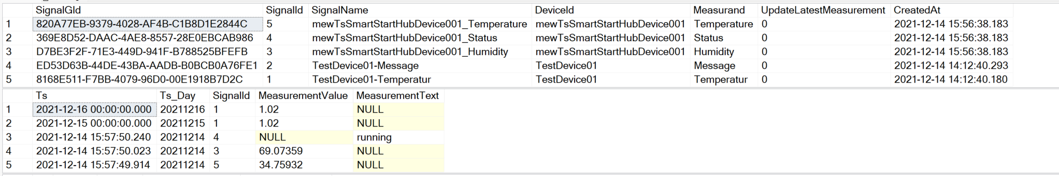
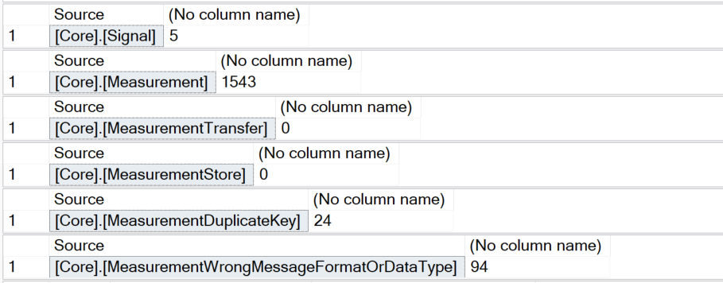

Quick Overview of data in the database
EXEC [Core].[GetOverviewOfDataInDatabase]

Slide 42




Remove Data from Measurement<XXX> table
EXECUTE [Partition].[RemoveDataPartitionsFromTable]
@SchemaName = 'Core'
,@TableName = 'MeasurementStore'
,@TS_Day_LowWaterMark = 20211201
,@TS_Day_HighWaterMark = 20211231
,@PreserveSwitchOutTable = 1
Table: [Core].[MeasurementStore]
(Month partition)
A 45.0
B 12.1
C 77.4
A 47.0
B 22.1
C 55.1
A 45.5
B 15.5
D 11.4
A 55.1
B 22.1
C 78.5
View:
[Core].[AllMeasurement]
Table:
[Core].[Measurement]
(Day partition)
A 45.4
B 42.1
D 15.4
A 45.1
B 12.5
C 77.8
A 35.0
B 15.1
C 75.5
A 45.3
B 18.9
C 67.4
20211228
20211229
20211230
20211231
20220102
20220103
20220104
…
20220101
20220201
[Core].[SwitchedOut_MeasurementStore_20211201_2021-12-14T18:53:05.363]

Slide 43


Remove Data from Measurement<XXX> table -2
EXECUTE [Partition].[RemoveDataPartitionsFromTable]
@SchemaName = 'Core'
,@TableName = 'Measurement'
,@TS_Day_LowWaterMark = 20211214
,@TS_Day_HighWaterMark = 20211214
,@PreserveSwitchOutTable = 1
GO

Slide 44
Agenda
Goal and Solution Overview
Deploy Solution
Internals
Auto Signal Registration
Handle Duplicate Values
Storage Details
Poor man’s digital twin
Restrict Data Access
Efficient Queries/Power BI
Monitor activity/reset the database
Database Tiers

Slide 45

Poor man’s digital twin
The question “What is the last know value of a given Signal” can not use “Partition Elimination”
The Table [Core].[LatestMeasurement] contains the latest know value
If [UpdateLatestMeasurement] is set to «true» in [Core].[Signal]
Keeping the table up to date adds some overhead to the system -> update can be enabled if required
Also, helpful to see end-to-end latency of the whole chain

Slide 46
Agenda
Goal and Solution Overview
Deploy Solution
Internals
Auto Signal Registration
Handle Duplicate Values
Storage Details
Poor man’s digital twin
Restrict Data Access
Efficient Queries/Power BI
Monitor activity/reset the database
Database Tiers

Slide 47
Data ingest and presentation
Avoid duplicate delivery of events
(Keep them for quality control)
Deal with mal formed events
(Keep them for quality control)
Show data only allowed rows, company internal but also for third party users
IoT Hub
Stream Analytics
Azure SQL Database
Keep history of all security relevant meta data changes
Replace signal name with internal SignalId
Reference
Data

Slide 48
Azure SQL Database
Ingest
Core
Mart
Stream Analytics
Row level security

Slide 49
Row level security
CREATE FUNCTION [Security].[fn_datapointsecuritypredicate]
(@DataPointId AS int)
RETURNS TABLE
WITH SCHEMABINDING
AS
RETURN SELECT 1 AS fn_datapointsecuritypredicate_result
WHERE (@DataPointId
IN (
-- REGULAR USER
SELECT DISTINCT [DataPointId]
FROM [Security].[ApplicationRoleDataPointAccess]
INNER JOIN [Security].[ApplicationRoleMember]
ON [ApplicationRoleDataPointAccess].[RoleId] = [ApplicationRoleMember].[RoleId]
WHERE [ApplicationRoleMember].[UserId] = SYSTEM_USER
)
)
OR
( -- ADMIN USER EXISTS (SELECT 'x' FROM [Security].[ApplicationRoleMember]
WHERE [RoleId] = 'ApplicationAdmin'
AND [UserId] = SYSTEM_USER)
)
CREATE SECURITY POLICY [dbo].[DataPointFilter]
ADD FILTER PREDICATE [Security].[fn_datapointsecuritypredicate]([SignalId])
ON [Core].[Signal]
WITH (STATE = ON, SCHEMABINDING = ON)

Slide 50

Security related tables

Slide 51
Performance Optimization(Unique Key reference)
CREATE TABLE [Security].[ApplicationUser]
(
[ApplicationUserGId] UNIQUEIDENTIFIER NOT NULL DEFAULT NEWID(),
[UserId] [sysname] NOT NULL CONSTRAINT [UK_Security_ApplicationUser_UserId] UNIQUE([UserId]),
[Remark] VARCHAR (255) NULL,
[CreatedBy] [sysname] NOT NULL CONSTRAINT [df_Security_ApplicationUser_createdby] DEFAULT (suser_sname()),
[ValidFrom] DATETIME2 (7) GENERATED ALWAYS AS ROW START
NOT NULL,
[ValidTo] DATETIME2 (7) GENERATED ALWAYS AS ROW END
NOT NULL,
PRIMARY KEY NONCLUSTERED ([ApplicationUserGId] ASC),
PERIOD FOR SYSTEM_TIME ([ValidFrom], [ValidTo])
)
WITH (SYSTEM_VERSIONING = ON (HISTORY_TABLE=[Security].[ApplicationUserHistory], DATA_CONSISTENCY_CHECK=ON));
CREATE TABLE [Security].[ApplicationRoleMember] (
[ApplicationRoleMemberGId] UNIQUEIDENTIFIER NOT NULL DEFAULT NEWID(),
[RoleId] [sysname] NOT NULL,
[UserId] [sysname] NOT NULL,
[Remark] VARCHAR (255) NULL,
[CreatedBy] [sysname] NOT NULL CONSTRAINT [df_rolemember_createdby] DEFAULT (suser_sname()),
[ValidFrom] DATETIME2 (7) GENERATED ALWAYS AS ROW START NOT NULL,
[ValidTo] DATETIME2 (7) GENERATED ALWAYS AS ROW END NOT NULL,
CONSTRAINT [PK_security_applicationrolemember] PRIMARY KEY NONCLUSTERED ([ApplicationRoleMemberGId] ASC),
CONSTRAINT [UK_security_applicationrolemember] UNIQUE CLUSTERED ([UserId] ASC, [RoleId] ASC),
CONSTRAINT [FK_ApplicationRoleMember_ApplicationRole] FOREIGN KEY ([RoleId]) REFERENCES [Security].[ApplicationRole] ([RoleId]),
CONSTRAINT [FK_ApplicationRoleMember_ApplicationUser] FOREIGN KEY ([UserId]) REFERENCES [Security].[ApplicationUser] ([UserId]),
PERIOD FOR SYSTEM_TIME ([ValidFrom], [ValidTo])
)
WITH (SYSTEM_VERSIONING = ON (HISTORY_TABLE=[Security].[ApplicationRoleMemberHistory], DATA_CONSISTENCY_CHECK=ON));

Slide 52

Temporal Table for Security related tables
CREATE TABLE [Security].[ApplicationUser]
(
[ApplicationUserGId] UNIQUEIDENTIFIER NOT NULL DEFAULT NEWID(),
[UserId] [sysname] NOT NULL CONSTRAINT [UK_Security_ApplicationUser_UserId] UNIQUE([UserId]),
[Remark] VARCHAR (255) NULL,
[CreatedBy] [sysname] NOT NULL CONSTRAINT [df_Security_ApplicationUser_createdby] DEFAULT (suser_sname()),
[ValidFrom] DATETIME2 (7) GENERATED ALWAYS AS ROW START
NOT NULL,
[ValidTo] DATETIME2 (7) GENERATED ALWAYS AS ROW END
NOT NULL,
PRIMARY KEY NONCLUSTERED ([ApplicationUserGId] ASC),
PERIOD FOR SYSTEM_TIME ([ValidFrom], [ValidTo])
)
WITH (SYSTEM_VERSIONING = ON (HISTORY_TABLE=[Security].[ApplicationUserHistory], DATA_CONSISTENCY_CHECK=ON));

Slide 53
Agenda
Goal and Solution Overview
Deploy Solution
Internals
Auto Signal Registration
Handle Duplicate Values
Storage Details
Poor man’s digital twin
Restrict Data Access
Efficient Queries/Power BI
Monitor activity/reset the database
Database Tiers

Slide 54
Effizient Queries
Partition elimination is key
declare @FromTs DATETIME = '2021-12-11 12:37:57.119'
,@ToTs DATETIME = '2021-12-11 13:37:57.119'
,@SignalId INT = 1
SELECT *
FROM [Core].[AllMeasurement]
WHERE [SignalId] = @SignalId
AND [Ts_Day] >= CONVERT(DATETIME, CONVERT(DATE, @FromTs))
AND [Ts_Day] <= CONVERT(DATETIME, CONVERT(DATE, @FromTs))
AND [Ts] >= @FromTs
AND [Ts] <= @ToTs
SELECT *
FROM [Mart].[GetMeasurementForSignal] (1 ,'2021-12-11 12:37:57.119' ,'2021-12-11 13:37:57.119')
Table: [Core].[MeasurementStore]
(Month partition)
A 45.0
B 12.1
C 77.4
A 47.0
B 22.1
C 55.1
A 45.5
B 15.5
D 11.4
View:
[Core].[AllMeasurement]
Table:
[Core].[Measurement]
(Day partition)
A 55.1
B 22.1
C 78.5
A 45.4
B 42.1
D 15.4
A 45.1
B 12.5
C 77.8
A 35.0
B 15.1
C 75.5
A 45.3
B 18.9
C 67.4
20210128
20210129
20210130
20210131
20210202
20210203
20210204
…
20210201
20210301

Slide 55


Query (Telemetry) Data Using Power BI
Import data
Hybrid mode
Direct query mode
Partition elimination table
Moving window function
SQL Database
Power BI Dataset

Slide 56



Time zone handling View: [MartPowerBI].[Measurement]
Core
Mart/MartPowerBI
According to configured time zone (visible in Ts_Timezone)
Assuming values in [Core].[Measurement] are stored in UTC

Slide 57




Time zone handling TVF: [Mart].[GetMeasurementForRelativeTimeWindow]
SELECT [Ts_UTC], [Ts], [Ts_Day], [Ts_Day_UTC], [Ts_Day] ,[SignalId], [MeasurementValue], [Ts_Timezone]
FROM [Mart].[GetMeasurementForRelativeTimeWindow] ('DAY-3' -- Time window *)
,'2022-07-23 08:26:00' -- End time (UTC)
,Default) -- Time zone
WHERE SignalId = 1
ORDER BY Ts_UTC
[Core].[Measurement]
SELECT [Ts_UTC], [Ts], [Ts_Day], [Ts_Day_UTC], [Ts_Day] ,[SignalId], [MeasurementValue], [Ts_Timezone]
FROM [Mart].[GetMeasurementForRelativeTimeWindow] ('DAY-3' -- Time window *)
,'2022-07-23 08:26:00’ -- End time (UTC)
,'E. Europe Standard Time') -- Time zone
WHERE SignalId = 1
ORDER BY Ts_UTC
*) Supported Time Windows metrics
'SECOND'
'MINUTE'
'HOUR'
'DAY'
'MONTH'
'YEAR'

Slide 58

Power BI Hybrid Mode
Hybrid tables are very efficient if partition elimination can be used on the SQL Server side
The partition key in the [Core].[Measurement] table is based on an INT column
Power BI expects a column of the type “DateTime”
Conversion can be implemented via a simple M-Function
Configure incremental refresh and real-time data for Power BI datasets - Power BI | Microsoft Docs

Slide 59



Power BI Hybrid Mode - 2

Slide 60




Power BI Hybrid Mode - 3

Slide 61





Direct Query Mode - A
Main “time” filter =
Partition elimination

Slide 62





Direct Query Mode - B
Table
Table Valued Function
SQL Server Function + PBI Dynamic M Parameter
[Core].[Measurement]
[Mart].[GetMeasurementForRelativeTimeWindow]
(
@DeltaTime VARCHAR(25)
,@EndDateTime_UTC DATETIME2(3)
,@TargetTimeZone VARCHAR(50) = 'Central European Standard Time'
)
Notes:
select distinct *
from
(
select Ts_Day, SignalId, MIN(ts) as Ts, MIN(MeasurementValue) as MeasurementValue
from Core.Measurement
group by Ts_Day, SignalId
union all
select Ts_Day, SignalId, Max(ts) as Ts, Max(MeasurementValue) as MeasurementValue
from Core.Measurement
group by Ts_Day, SignalId
) as x
where SignalId in (1,2)
order by 1,2,3

Slide 63







Direct Query Mode – B (2)
Table
Parameter

Slide 64
Direct Query Mode – B (3)
CREATE FUNCTION [Mart].[GetMeasurementForRelativeTimeWindow]
( @DeltaTime VARCHAR(25)
,@EndDateTime_UTC DATETIME2(3)
,@TargetTimeZone VARCHAR(50) = 'Central European Standard Time'
)
RETURNS TABLE
AS
RETURN
With [GetMeasurement]
as
( SELECT [Ts] AS [Ts_UTC]
,CONVERT(DATETIME2(3),CONVERT(DATETIMEOFFSET, [Ts]) AT TIME ZONE @TargetTimeZone) AS [Ts]
,[Ts_Day] AS [Ts_Day_UTC]
,[SignalId]
,[MeasurementValue]
,[MeasurementText]
,CONVERT(VARCHAR(12), CONVERT(TIME(3), [Ts], 121)) AS [Ts_Time_UTC]
,CONVERT(INT, CONVERT(VARCHAR, CONVERT(DATETIMEOFFSET, [Ts]) AT TIME ZONE @TargetTimeZone, 112)) AS [Ts_Day]
,CONVERT(VARCHAR(12), CONVERT(time(3), CONVERT(DATETIMEOFFSET, [Ts]) AT TIME ZONE @TargetTimeZone)) AS [Ts_Time]
FROM [Core].[AllMeasurement]
CROSS JOIN [Mart].[GetRelativeTimeWindow] (@DeltaTime, @EndDateTime_UTC, @TargetTimeZone) AS GRTW
WHERE [Ts_Day] >= GRTW.[Ts_DayStartDate_UTC]
AND [Ts_Day] <= GRTW.[Ts_DayEndDate_UTC]
AND [Ts] >= GRTW.[StartDateTime_UTC]
AND [Ts] <= GRTW.[EndDateTime_UTC]
)
SELECT
[Ts_UTC]
,[Ts]
,[SignalId]
,[MeasurementValue]
,[MeasurementText]
,[Ts_Day_UTC]
,[Ts_Time_UTC]
,[Ts_Day]
,[Ts_Time]
,LEFT([Ts_Time],2) AS [Ts_Hour]
,SUBSTRING([Ts_Time],4,2) AS [Ts_Minute]
,SUBSTRING([Ts_Time],7,2) AS [Ts_Second]
,SUBSTRING([Ts_Time],10,3) AS [Ts_Millisecond]
,@TargetTimeZone AS [Ts_Timezone]
FROM [GetMeasurement]

Slide 65
Agenda
Goal and Solution Overview
Deploy Solution
Internals
Auto Signal Registration
Handle Duplicate Values
Storage Details
Poor man’s digital twin
Restrict Data Access
Efficient Queries/Power BI
Monitor activity/reset the database
Database Tiers

Slide 66


Monitor Activites
Important operations are logged in the two tables:
[Logging].[TaskLog]
[Logging].[StepLog]
Combined in View [Logging].[LogInfo]
SELECT * FROM [Logging].[TaskLog]
SELECT * FROM [Logging].[StepLog]

Slide 67
Reset the database
Data from the following tables
[Core].[Signal]
[Core].[Measurement]
[Core].[MeasurementTransfer]
[Core].[MeasurementStore]
[Core].[MeasurementDuplicateKey]
[Core].[MeasurementWrongMessageFormatOrDataType]
[Core].[OptimizerInfo]
[Logging].[TaskLog]
[Logging].[StepLog]
can be deleted with the stored procedure
[Partition].[EmptyAllDataTablesYesImConfidentToDo]
The two sequences will also be reset to a start value of 1
[Core].[Id]
[Logging].[LogSequence]
Restart Stream Analytics after a reset, to update cached meta data!

Slide 68
Data ingest and presentation
Instead of Trigger “API – View Layer”
~ 20 lines of T-SQL code
Stream Analytics
~ 20 lines of SQL code
Declarative Row Level Security
~ 20 lines of T-SQL code
Avoid duplicate delivery of events
(Keep them for quality control)
Deal with mal-formed events
(Keep them for quality control)
Show data only allowed rows, company internal but also for third party users
IoT Hub
Stream Analytics
Azure SQL Database
Keep history of all security relevant meta data changes
Replace signal name with internal SignalId
Reference
Data
Temporal Tables
0 lines of T-SQL code
Reference Data in Stream Analytics
~ 5 lines of SQL code

Slide 69
Agenda
Goal and Solution Overview
Deploy Solution
Internals
Auto Signal Registration
Handle Duplicate Values
Storage Details
Poor man’s digital twin
Restrict Data Access
Efficient Queries/Power BI
Monitor activity/reset the database
Database Tiers

Slide 70








Relational
SQL
SQL
MySQL
PostgreSQL
MariaDB
SQL Server in Azure
SQL Server Hyperscale
Azure SQL Data Warehouse
Key-Value, Documents, …
MongoDB API
Table API
Non
Relational
Azure Cosmos DB
Files
Hadoop
Databricks
Azure Data Lake Storage
Some GB to a few TB
Many TB
to some PB

Slide 71




Azure SQL Database Family
Azure SQL DB
Azure SQL Server Hyperscale
Azure Synapse Analytics SQL Pool
DB
[Cache]
Azure SQL Serverless

Slide 72

Scalability
Build your full-PaaS IoT solution with Azure SQL Database - Microsoft Tech Community
Scaling up an IoT workload using an M-series Azure SQL database - Microsoft Tech Community

Slide 73
Current Data Volume (after ~ 6 months up and running)
20’000’000 events per day
Avg 230 events per second
Peak 20’000 events per second
3'881'478'093 events currently stored in database
Multiple ML Jobs running in the background
~ 20 Interactive Users

